Slide 1

EE216 Reconfigurable Computing
Topic 9： Software/Hardware Co-Design with SDSoC
Prof. Yajun Ha
ShanghaiTech University
Shanghai, China
Notes:
Title
FirstName LastName – Activity / Group

Slide 2

SW/HW Co-Design Flow
SDSoC Overview
SDSoC design flow
Profiling
Notes:
Title
FirstName LastName – Activity / Group

Slide 3
SW/HW Co-Design Flow
Algorithm Functional Modeling
Problem Partitioning
Algorithms
Software Func. Model
SW/HW
Interface
Hardware Func. Model
Software Development
High Level Synthesis
Application Source Code
Logic/Physical Synthesis
Processors
Application Specific
Hardware(ASIC/FPGA)
Platforms
SW/HW Interface
Notes:
Title
FirstName LastName – Activity / Group

Slide 4
SDSoC Overview
SDSoC provides a familiar embedded C/C++ application development experience including
  An easy to use Eclipse IDE
  A comprehensive design environment for heterogeneous Zynq SoC and MPSoC
  C/C++ full-system optimizing compiler
SDSoC enables function acceleration in PL with a click of button using various technologies, such as Vivado IPI, Vivado HLS, SDK, and Profiler
SDSoC provides infrastructure to combine processing system, accelerators, data movers, signaling, and drivers
  Whereas the Vivado HLS tool only build the RTL; connectivity, supporting IP drivers etc. must be supplied by the designer

Slide 5
Benefits of SDSoC?
Shorter development cycles
  Estimation shows improvement over software-only solution for system and accelerators
  Iterative improvement can be made at early stages of development without the need to build hardware
Simplified interface and partitioning between hardware and software
  Software-based flow vs RTL
Automated initial design
  Users can tweak code at macro- and micro-architectural levels
  Designers still have manual control over the constructed Vivado HLS tool and Vivado Design Suite projects

Slide 6
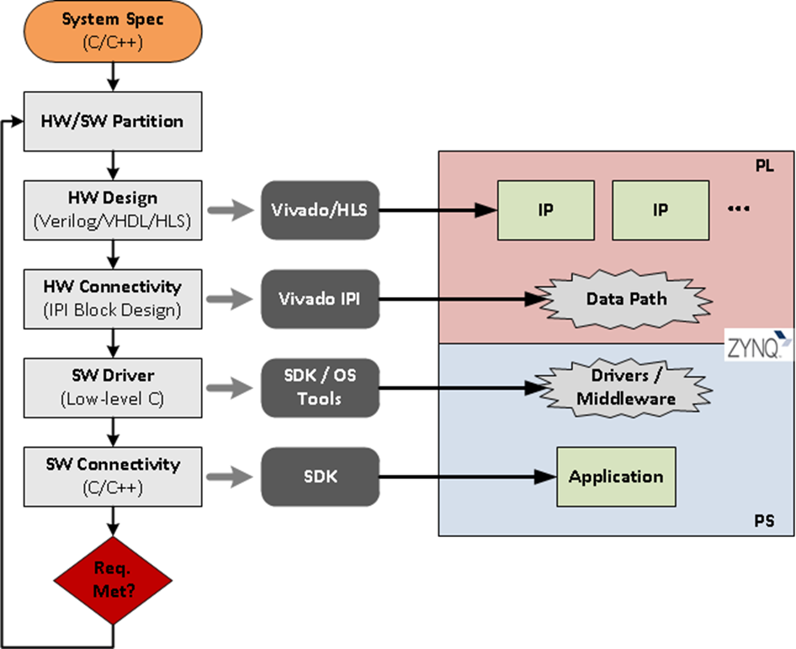
Development Flow Without SDSoC
Overall process requires expertise at all steps in the development process
  Various hardware design entries
  Hardware connectivity at system level
  Driver development to drive custom hardware
  Integrating with application and target OS

Slide 7
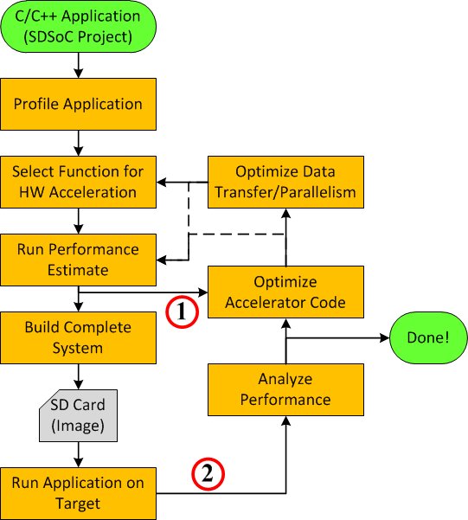
Development Flow with SDSoC
Without hardware generation, the SDSoC development environment acts like a normal C/C++ IDE
With SDSoC it starts with a pure software system and ends with an accelerated SW/HW system
Estimate provides quick-turns to get architectures close
Release generates full hardware/software products

Slide 8
SW/HW Co-Design Flow
SDSoC Overview
SDSoC design flow
Profiling
Notes:
Title
FirstName LastName – Activity / Group

Slide 9

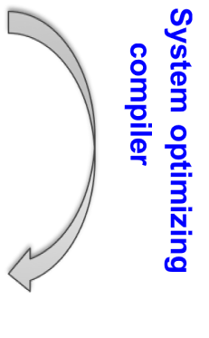

SDSoC Development Flow
madd(inA,inB,out){
}
main(){
init(A,B,C);
mmult(A,B,D);
madd(C,D,E);
consume(E);
}
mmult(inA,inB,out){
}
Optimized RTL IP
HLS
cross-
compiled
C-callable IP
Synthesizable
C/C++
Fast performance estimation
App
SW
PS
PL
A,B
mmult
SW glue code
D
C
madd
E
OS, BSP
Target Board
Compiler infers data communication, uses data mover IP
System linker generates hardware system, software stubs, APIs and configuration
Boot image incl. ELF+.BIT
Platform (can incl. PL)

Slide 10
Users Must Keep in Mind
Tools abstract away many of the challenges
  Novices can attain some basic level of results
  Full performance only comes with understanding
The Vivado HLS tool
  The SDSoC development environment does not perform any code optimizations
  The Vivado HLS tool skills are very important to achieve optimal performance
  Understanding the Zynq AP SoC architecture is also beneficial
C/C++
  Tools are GNU based
  New C learners should follow a non-SDSoC development environment flow
  Familiarity with refactoring for the SDSoC development environment

Slide 11
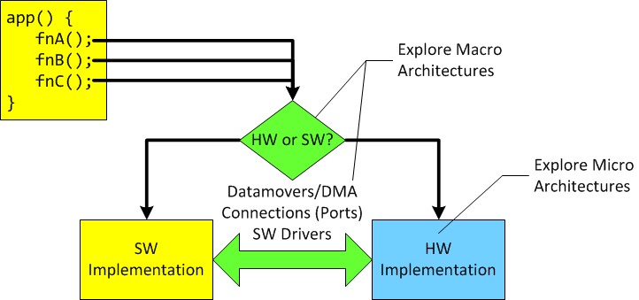
System-level Considerations
What gets accelerated?
How is software implemented in hardware?
  Is hardware design expertise available?
How will software and hardware talk to each other?
Will it meet performance requirements the first try?
  What changes are required at the macro/micro-architecture levels
© Copyright 2017 Xilinx

Slide 12
Candidate for an Accelerator
Not every function can be a candidate for acceleration
  For example, pre-compiled code, some user libraries, OS services, etc.
Computationally intensive algorithms are ideal candidates
  Profiling results help identify performance bottlenecks
    Just because a function takes a long time, it is not automatically a candidate
  Slight code modifications (or pragmas) effect the microarchitecture of the accelerator
Trade-off between data movement costs and acceleration benefits should be considered

Slide 13
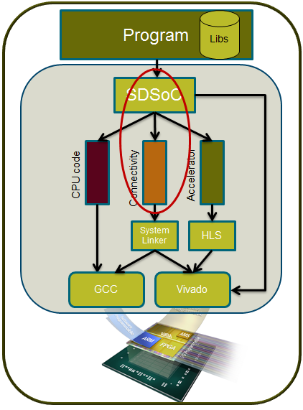
Simplifying Hardware/Software Partitioning
SDSoC simplifies the process of identifying and accelerating functions
  Integrates profiling tools
  Provides libraries for accurate timing measurements
  User selects functions to accelerate
  Estimates hardware speed-up
Automated acceleration is achieved through
  Advanced analysis of code using specialized compilers
  Assistance of user-specified pragmas
  Extension of a predefined hardware platform
Hardware platforms packaged with the
environment and from third parties
  Environment extends platform, providing additional capabilities

Slide 14









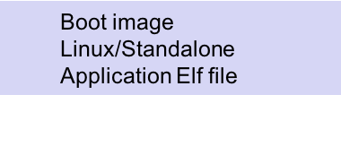

Development Flow
C/C++ Application running on ARM
Specify platform
Specify OS
Specify functions to move to HW
Specify monitor points
Profile Application
Optimize data transfer and parallelism using SDSoC guidelines
User-assisted SW-HW partitioning based on profiling
Select functions to move to HW
Optimize accelerator code
Run fast estimation
Analyze performance
Build application to generate software and hardware
SD Card Image
Run on the board

Slide 15
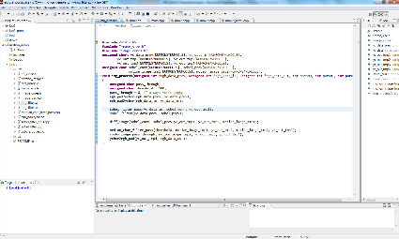
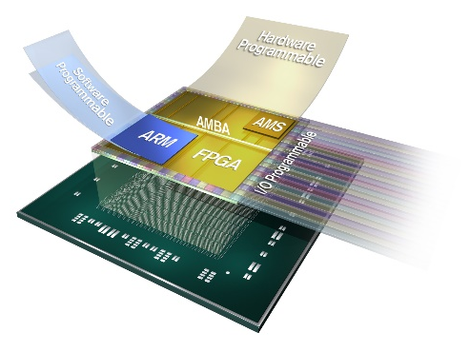
SDSoC: Complete End-to-End Flow
C/C++
Estimator
Compiler
Debugger
Profiler
Simple familiar SW development environment
Vivado
HLS
IP Integrator
HSM
ARM Compiler
Proven design tools and technologies
SW Code
PS
PL
A complete C to system flow!
IP
IP
Connectivity
Generated driver
IP
IP
OS, BSP
Target Board
Platform

Slide 16
Development Flow
Without hardware generation, the SDSoC development environment acts like a normal C/C++ IDE
With SDSoC it starts with a pure software system and ends with an accelerated SW/HW system
Developers select C functions for hardware acceleration
Estimate provides quick-turns to get architectures close
  Used in early development
Release generates full hardware/software products
  For later and final stages of development
© Copyright 2017 Xilinx

Slide 17
Profiling the Application
The goal of offloading software to hardware is to improve overall system performance
Finding software eligible for acceleration follows general software optimization practices
  Profiling yields the necessary data by summarizing where execution time was spent
The SDSoC development environment includes the TCF profiling tool
  No code instrumentation or special recompiling required
  Profiling results show percentage of time spent in functions relative to a total execution time
For absolute timing measurements sds_lib offers some functions for collecting system timer values
  Timer resource must be available and code must be changed to incorporate timer functions

Slide 18
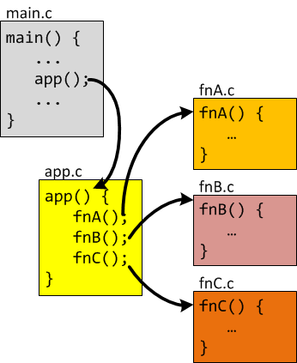
Accelerating Software Functions
Individual functions must be marked for acceleration
  Functions selected for acceleration are "hardware functions“
    Hardware functions can contain sub-functions
  Refactoring required if critical points are not isolated as functions
  Each function becomes an individual piece of IP
OS-based platforms have only one master thread
communicates with all cores
Restrictions
  Only one function per file scope
    Splitting of files may be required to accelerate multiple functions
  Call to a hardware function must reside in a different file scope than the hardware function
  Other tool limitations may apply
    See Vivado HLS tool C/C++ guidelines

Slide 19
Estimating Performance
Enabling the Estimate Performance option builds a project only up to a point that performance estimates can be determined
  A complete Release or Debug build can take a long time
  The Estimate Performance option shows the impact of moving functions to hardware in only a few minutes
Comparison of hardware-accelerated system with original software-only system is accomplished by producing two separate sets of data, one for each scenario
  The Vivado HLS tool is used to produce data for hardware estimates
  Generated ELF must be run on the actual target to generate data for software estimates
  IDE provides a Report viewer that compares and illustrates the data

Slide 20
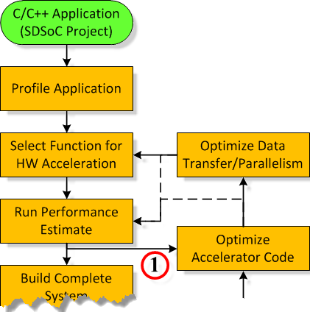
Initial Development Flow
Building with the Estimate Performance option yields
enough information to fine-tune optimization
First attempts often produce poorer performance
than software alone
  Typical when code has not been refactored and/or annotated
  for acceleration
Recommendation: Initial design iterations should use the
"short" path until performance improvements are seen
  Begin by optimizing code to improve accelerator performance, parallelism, and data flow
  Rebuild to observe impact of changes on estimates
  Repeat cycle until satisfactory results are achieved
Detailed system analysis and fine-tuning should be performed next
  Building and analyzing the full HW/SW system

Slide 21
Building the Complete System
Building a project is where SDSoC does all the heavy lifting
  Three basic methods to run the build process
    Through the IDE, using a makefile, directly from the command line
  It is during this step that SDSoC calls upon its internal framework and several sub-executables to accomplish
    (1) system compilation, (2) system analysis, (3) system generation
Activate the Release build configuration for a fully optimized build
A successful build will result in several output products including the following key items
  Application program in ELF format
  Bitstream (optional)
  SD card image (optional)
  Design projects (e.g. Vivado Design Suite and Vivado HLS tool)

Slide 22
Running the Application
Standalone applications do not require but can use an SD card
  When SD card is used, the SSBL in the binary file is replaced by the application ELF
    Boots directly to the application ELF
  Applications can be run from the IDE using an SDSoC tool Run configuration
SDSoC development environment requires use of an SD card to run applications for Linux
  Files required to run the application on hardware are grouped together as an SD card image
    First stage bootloader (FSBL), bitstream, and second stage bootloader (SSBL) embedded in a single binary file (BOOT.BIN)
    Linux kernel
    Application ELF
    Other miscellaneous files
  ELF must be explicitly run from the mounted SD card directory

Slide 23
Analyzing the Built System
The goal of this step is to analyze the performance of the updated hardware/software system
The same tools and techniques used initially apply here: profiling, instrumentation
  Profiler tool for relative software execution times
  Time-stamping functions provided through SDSoC API (sds_lib)
System consists of hardware and software with additional tools required for complete analysis
  Vivado HLS tool provides reports detailing generated hardware (included with output products)
  Vivado Design Suite can open the generated system hardware design to review additional reports, modify hardware
  SDSoC tool compiler can optionally insert an AXI performance monitor (APM) into the generated system
    APM monitors dataflow between the PS-PL

Slide 24
Optimizing the System
Optimizing the system is broken down into two steps: accelerator and then data flow and parallelism
Optimizing the accelerator consists of refining and/or annotating the hardware function (micro-architecture)
  Re-factoring code to be more HLS-friendly
  Adding code annotations (i.e., pragmas) that HLS can interpret and use to better optimize the accelerator
For system-level optimizations (data-flow/parallelism) there are several options (macro-architecture) including
  Using physically contiguous memory
  Using shared memory
  Using multiple instances of the same hardware
  Overriding HLS default behavior

Slide 25
SW/HW Co-Design Flow
SDSoC Overview
SDSoc design flow
Profiling
Notes:
Title
FirstName LastName – Activity / Group

Slide 26
Hardware and Software Partitioning
Determine the software "critical path" by profiling
  Profiling measures where the CPU is spending its cycles on a function-by-function or task-by-task basis
  Similar to timing analysis in hardware
  Informs the system designer which software routine may be a candidate to hardware-accelerate
Functions can be rewritten to improve efficiency in a number of ways
  Implementation in assembly code rather than C
  Writing faster C code, for example limit pointer use

Slide 27
What is Profiling?
Profiling is an analysis of software performance
  Where routine time is being spent
  How many times functions are being called
  Which algorithms to consider moving to hardware
Several methods
  TCF profiling
  PS performance monitoring
  Manual profiling

Slide 28
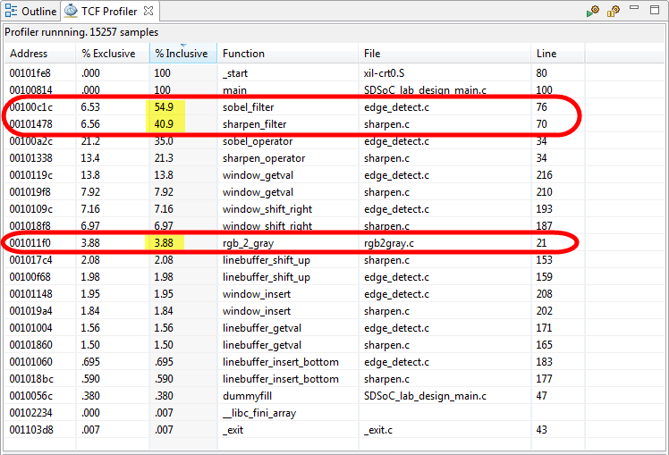
TCF Profiling
Non-invasive, uses ARM's PMU (CoreSight)
TCF profiling provides relative time
spent in a function as a percentage
  Inclusive and exclusive percentages included
No compiler flags need to be set
Profiling output can be sorted by
  Code address
  % exclusive, exclusive time
    Only time spent in the function is included
    (excluding all children function calls)
  % inclusive, inclusive time
    Include time spent in the function and spent in any functions called within
  Function name and file name

Slide 29
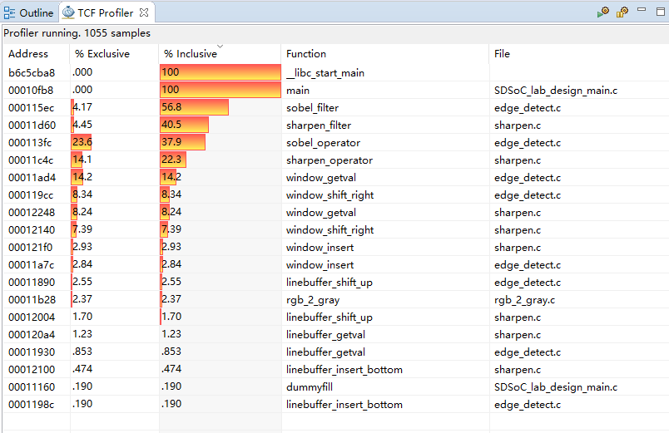
TCF Profiling

Slide 30
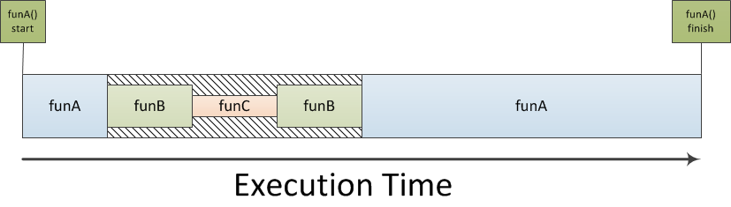
Inclusive vs Exclusive Execution Times
Exclusive: The amount of execution time spent in funA alone. Referencing the diagram below, the exclusive time for funA is represented by the combined execution time of the funA blocks only.
Inclusive: The amount of execution time spent in funA and all of its sub-function calls. From the diagram, this is the exclusive time of funA combined with the hatched area during which time funB and funC are executing.

Slide 31
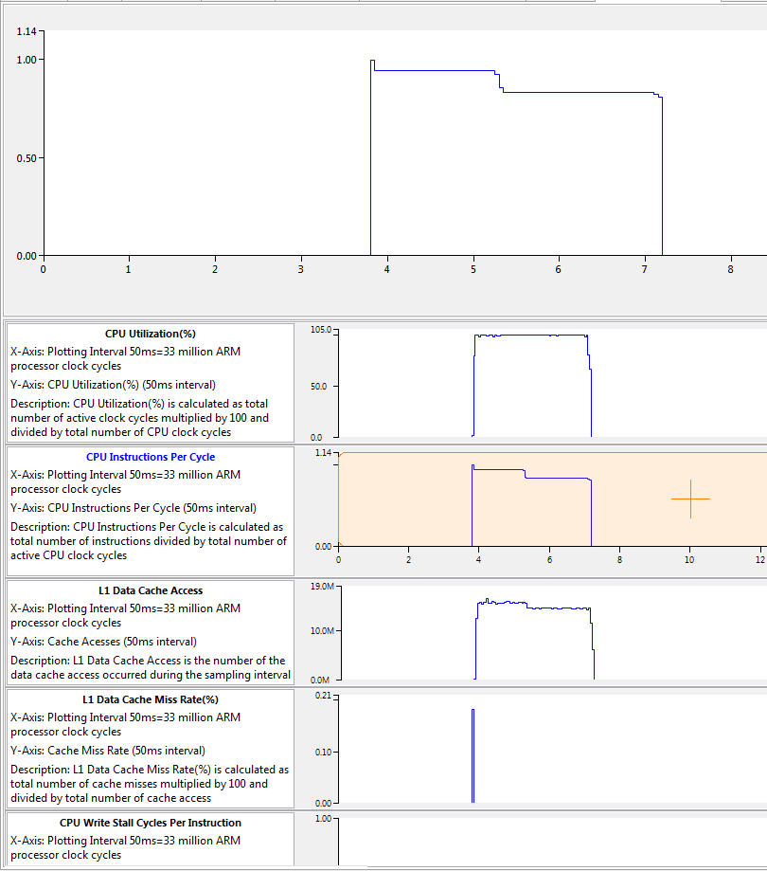
PS Performance Monitoring
The ARM PMU can provide information about APU performance
  Utilization percentage and instructions per cycle of either CPU
  L1 data cache miss rate
  CPU read/write stall cycles per instruction
Cumulative data can be viewed in the APU Performance view; visualization with respect to time is done using the PS Performance view in the SDSoC

Slide 32
PL Performance Monitoring
AXI performance monitor can be added
  Analyze AXI interface traffic
Collected data includes
  Write byte count
  Read byte count
  Write transaction count
  Total write latency
  Read transaction count
  Total read latency
Data can be viewed in the APU Performance view (cumulative reading) or in the PL monitoring view (data with respect to time)

Slide 33
Manual Profiling
The sds_lib library included in SDSoC provides a simple, source code annotation based time-stamping API that can be used to measure application performance
unsigned long long sds_clock_counter(void);
Using this API to collect timestamps and differences between them, you can determine duration of key parts of your program
  Implementation in assembly code rather than C
  Writing faster C code, for example limit pointer use
#include "sds_lib.h"
unsigned long long total_run_time = 0;
unsigned int num_calls = 0;
unsigned long long count_val = 0;
#define sds_clk_start(){ \
count_val = sds_clock_counter(); \
num_calls++; \
}
#define sds_clk_stop() {
long long tmp = sds_clock_counter();
total_run_time += (tmp - count_val);}
#define avg_cpu_cycles()
(total_run_time / num_calls)
sds_clock_start();
f();
sds_clock_stop();

Slide 34
Summary
The SDSoC development environment provides a familiar embedded C/C++ application development experience
Benefits of using SDSoC include
  Shorter development cycles
  Simplified interface and partitioning between hardware and software
SDSoC uses Vivado HLS, Vivado IPI, SDK tools
SDSoC project creation involves identifying workspace, entering project name, selecting target platform, selecting OS, and either selecting pre-defined application templates or creating empty application
Notes:
Title
FirstName LastName – Activity / Group

